Slide 1

GROUP C
Baldoni V., Boffa M., Fabiani F.,
Lanza C., Ravera A.
Master course in ICT for Smart Societies – Interdisciplinary Project Supervisor : Giacomo Chiesa

Slide 2

Effect of urbanistic action on social perspective
Master course in ICT for Smart Societies – Interdisciplinary Project Supervisor : Giacomo Chiesa

Slide 3
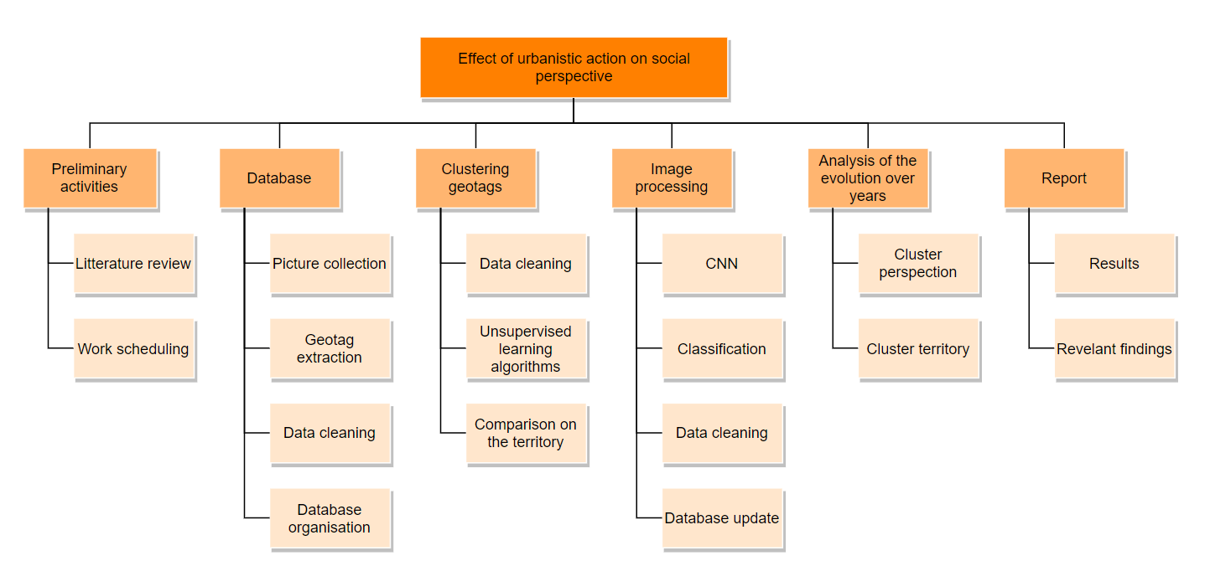
WORK PLAN
DONE
DONE
DONE
DONE
DONE
V
F
A
DONE
DONE
DONE
DONE
DONE
C
M
DONE
DONE
DONE
Chiara
Arianna
Matteo
Vincenzo
Federico
C
DONE
DONE
A
M
V
F

Slide 4








Test Readiness Review (TRR)
dropboxAPI
dropboxAPI
instaloader
flickrapi
pymongo
pymongo
.csv

Slide 5
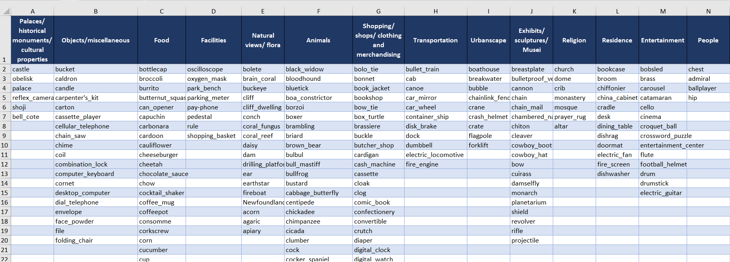
Test Readiness Review (TRR)
From Micro-classes to Macro-classes

Slide 6
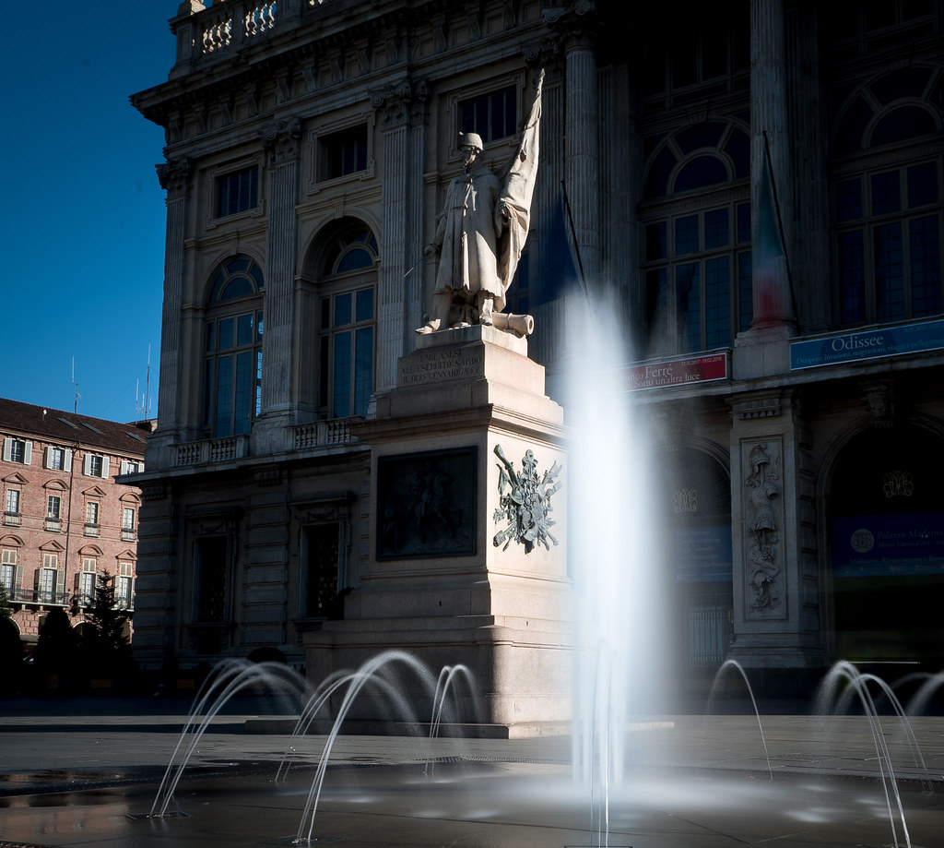
Test Readiness Review (TRR)
Micro-classes | Macro-classes | Percentages
Fountain | Urbanscapes | 0.888
Palace | Palaces | 0.030
Fireboat | Transportation | 0.006
Each picture will contribute to the score of its own zone:
Zone_x[Urbanscapes]+= 0.888
Zone_x[Palaces]+= 0.030
Zone_x[Transportation]+= 0.006

Slide 7

Test Readiness Review (TRR)
Intra-zone testing schedule:
Global analysis (2017-2019)
City Center focus
Weekends focus
Weekdays focus
Inconsistent tests
Consistent tests
Hourly comparison
2017 vs 2019
Spatial elasticity
Temporal elasticity
Lack of data

Slide 8
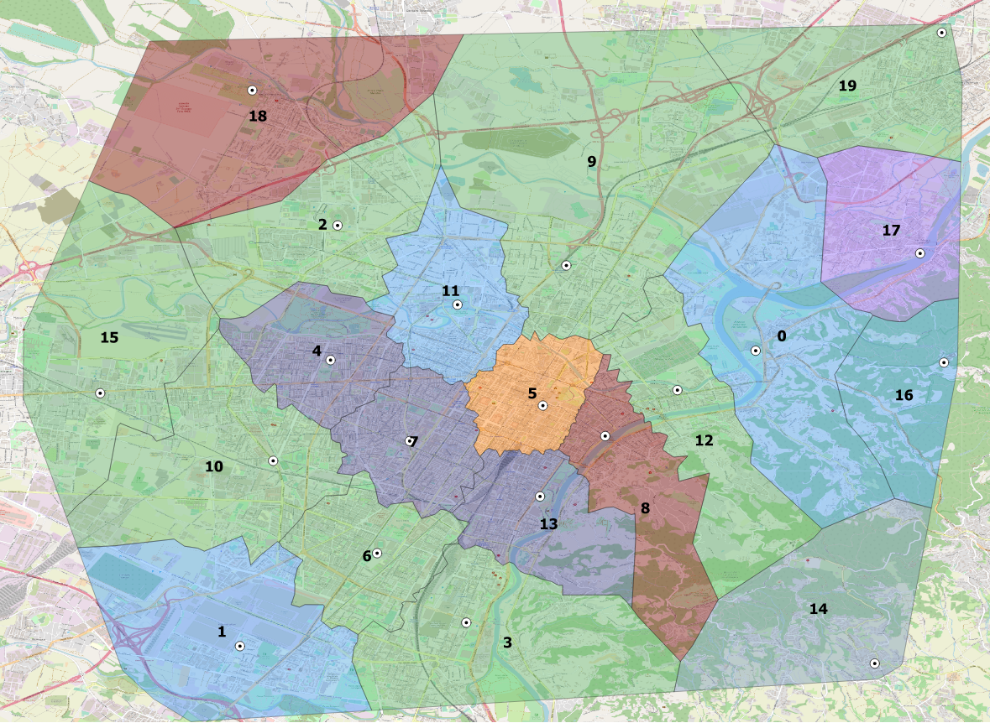
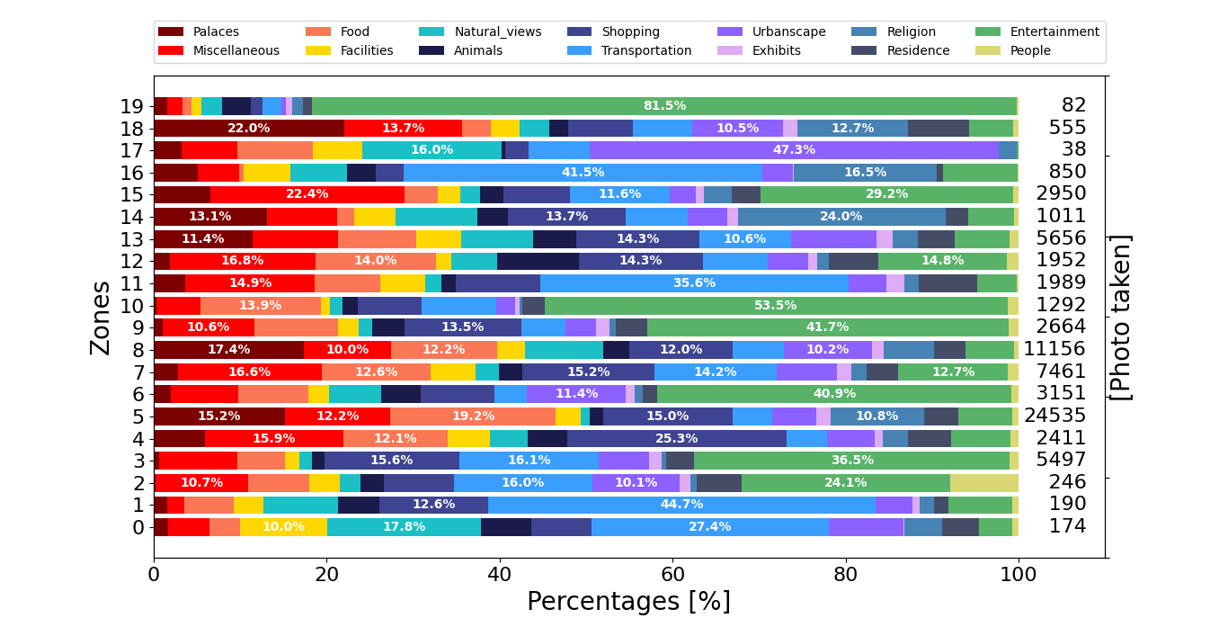
Test Readiness Review (TRR)
Global analysis (2017-2019)

Slide 9
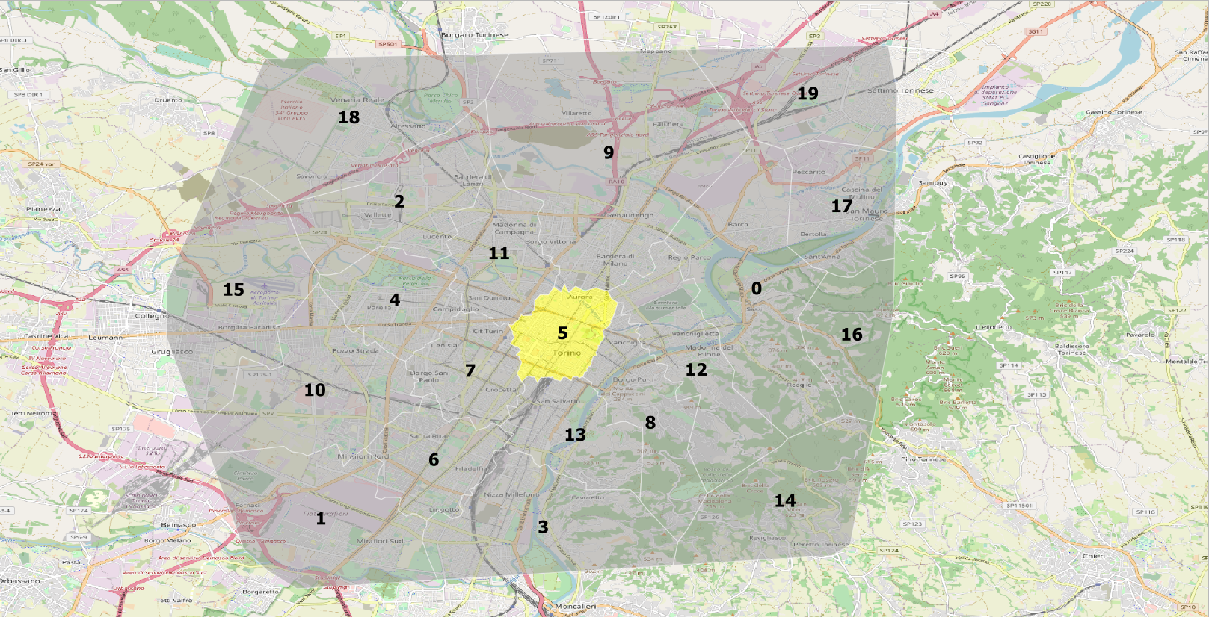
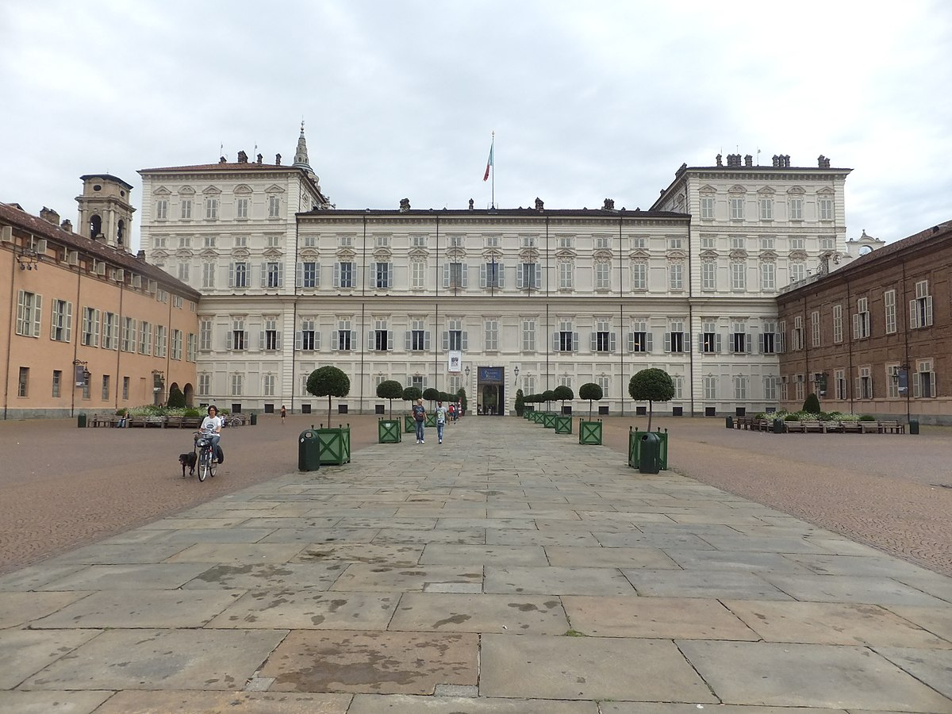
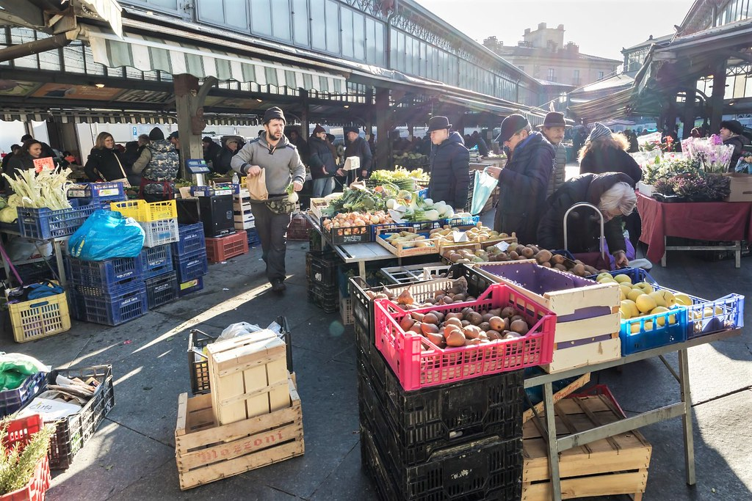
Test Readiness Review (TRR)

Slide 10
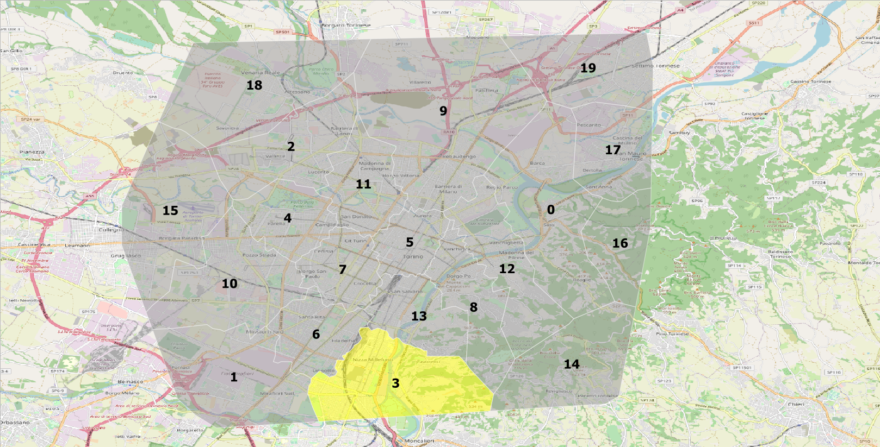
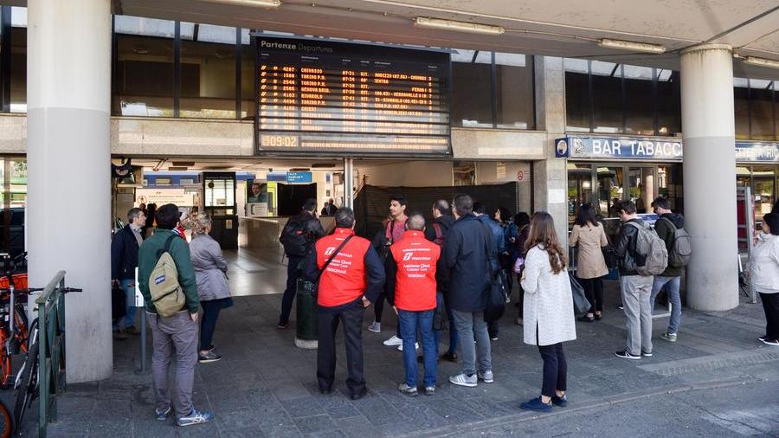

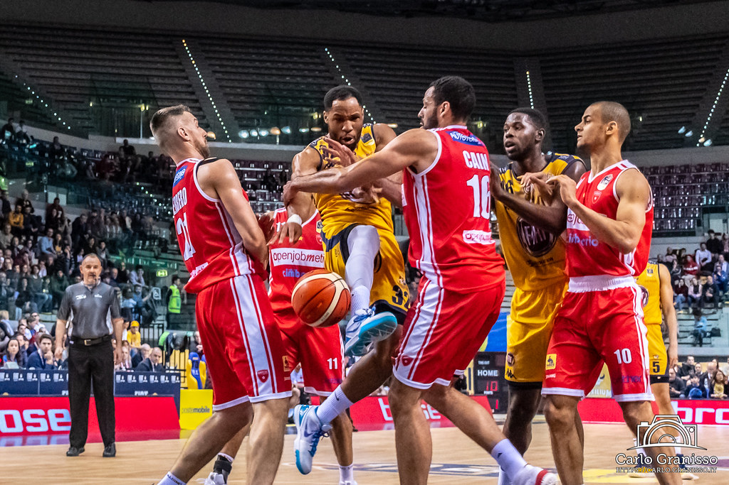
Test Readiness Review (TRR)

Slide 11
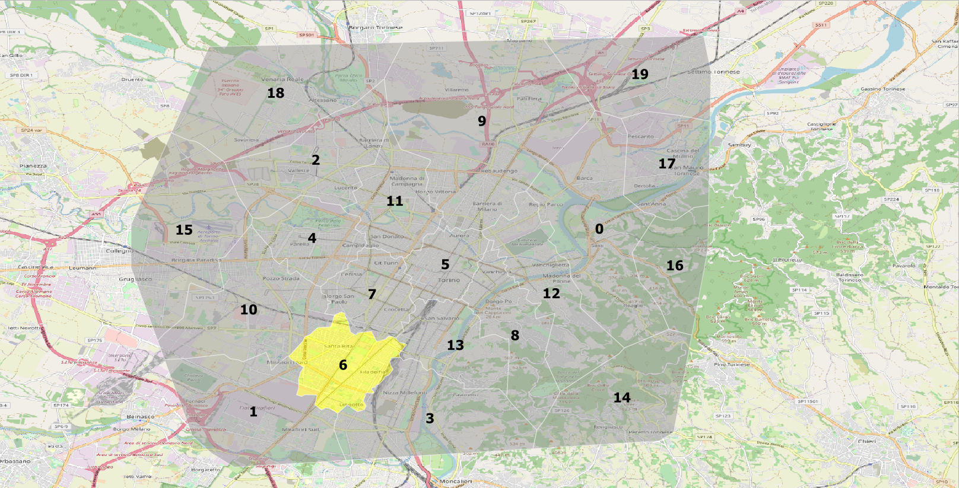

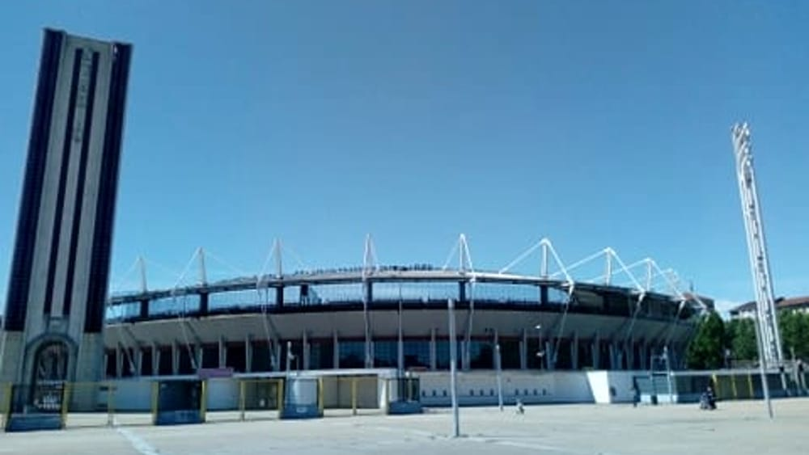
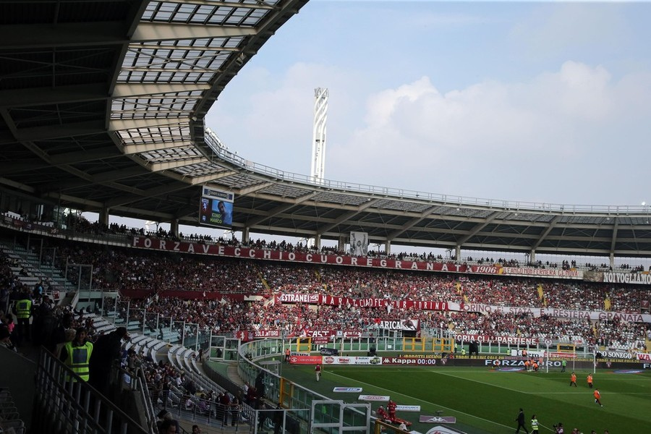
Test Readiness Review (TRR)

Slide 12
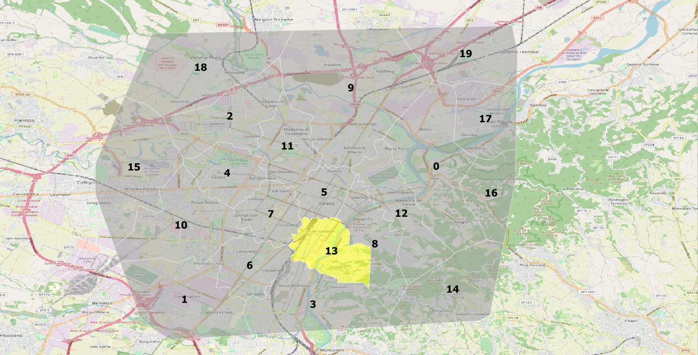
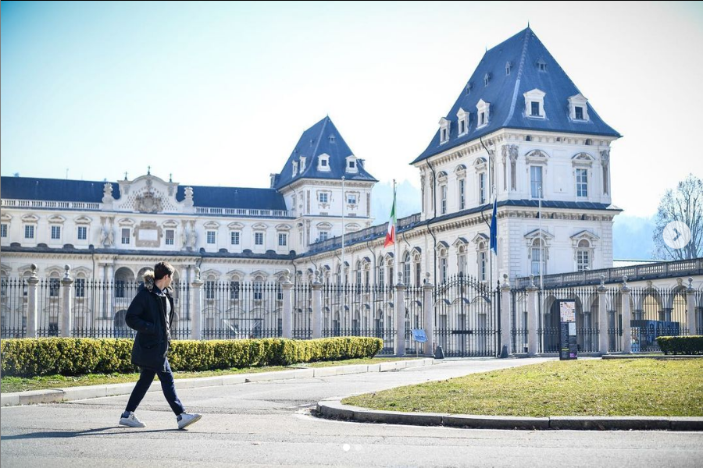
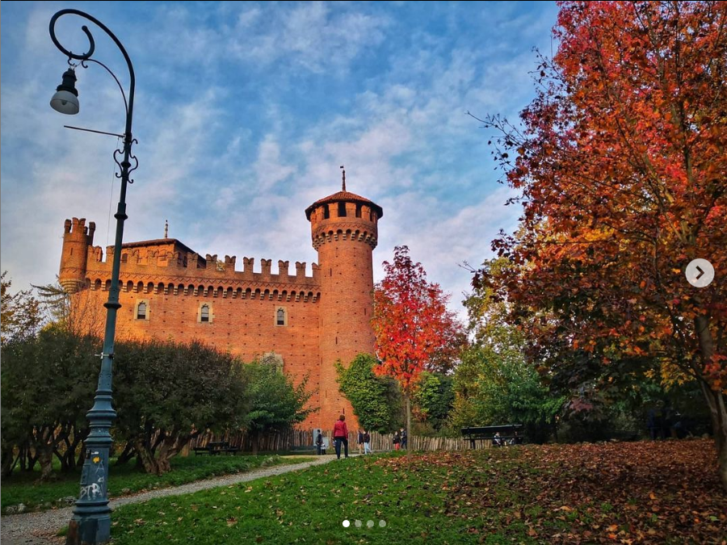
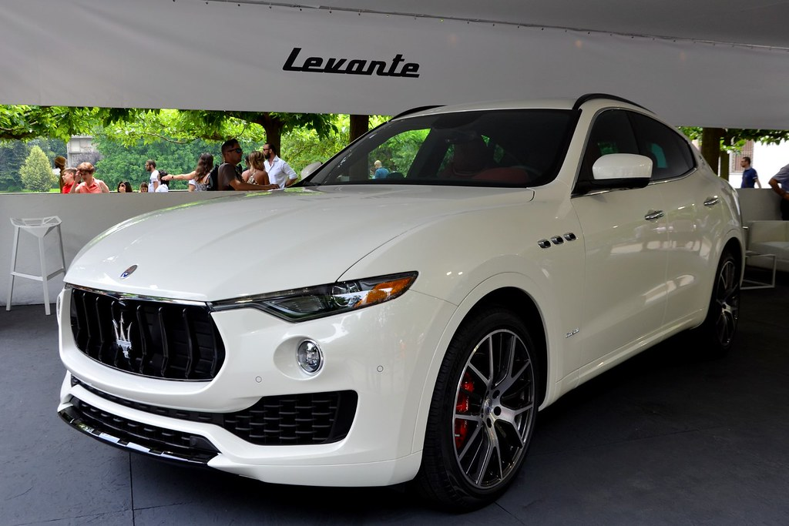
Test Readiness Review (TRR)

Slide 13
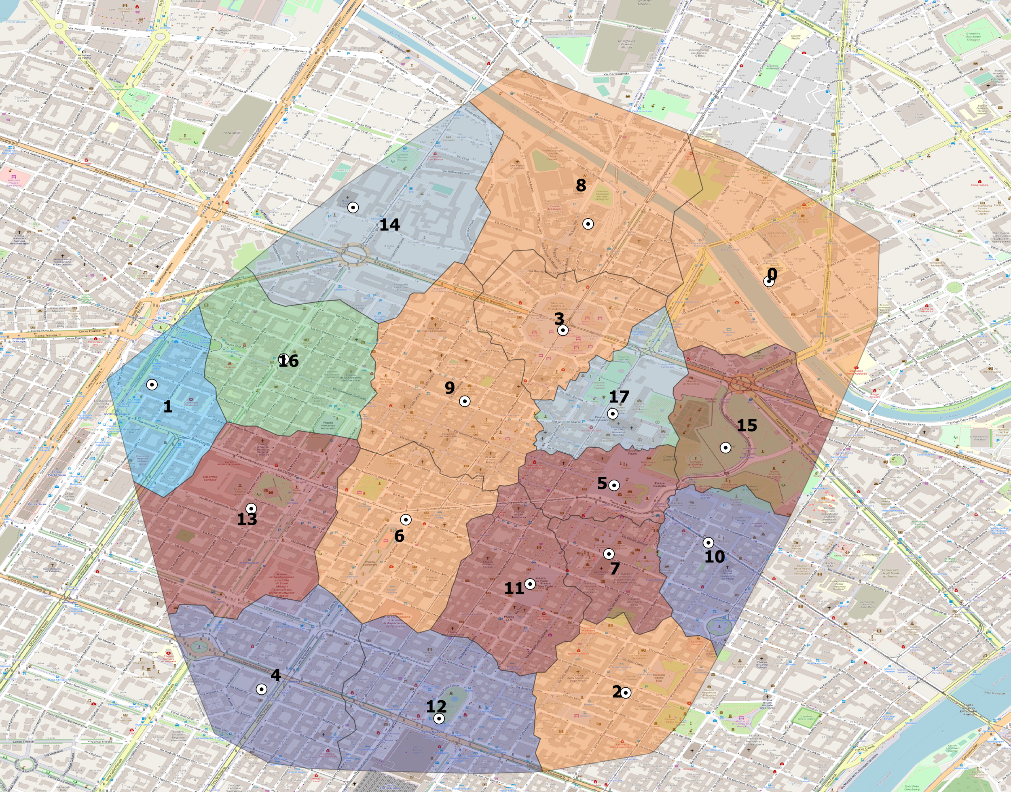
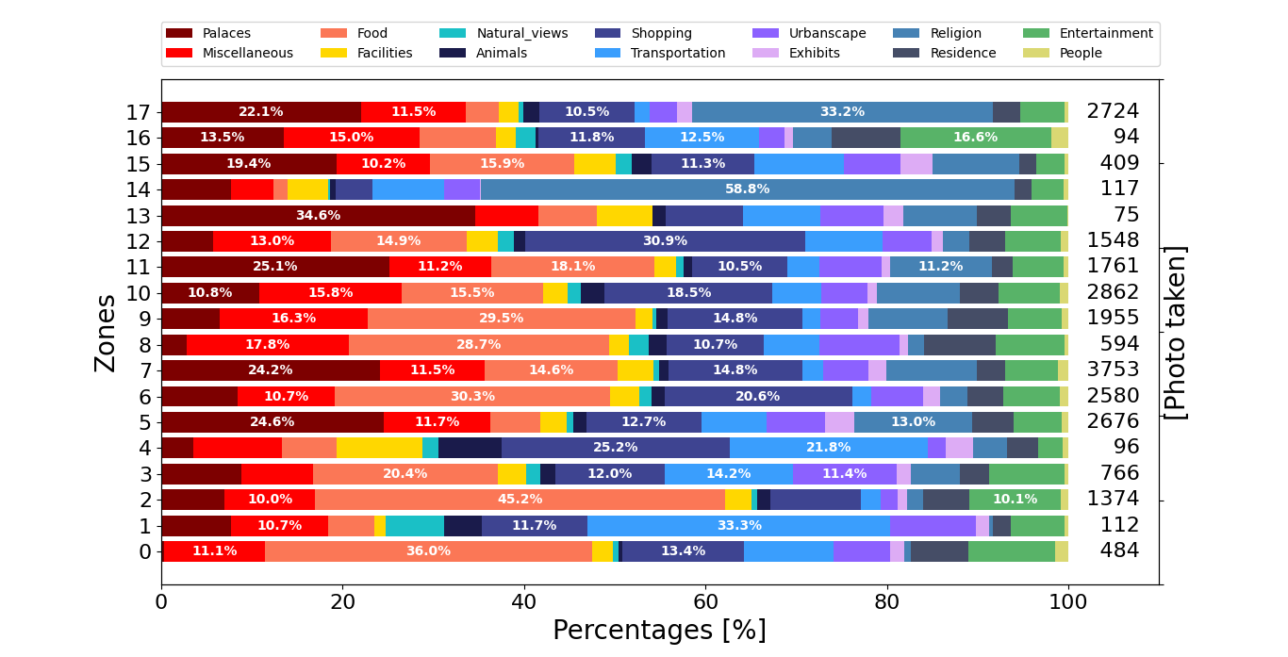
Test Readiness Review (TRR)
City Center focus

Slide 14
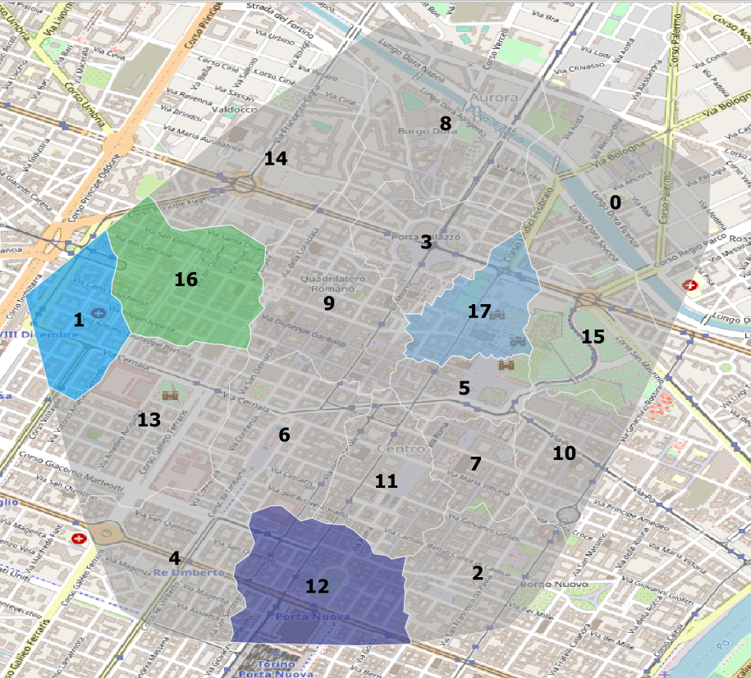
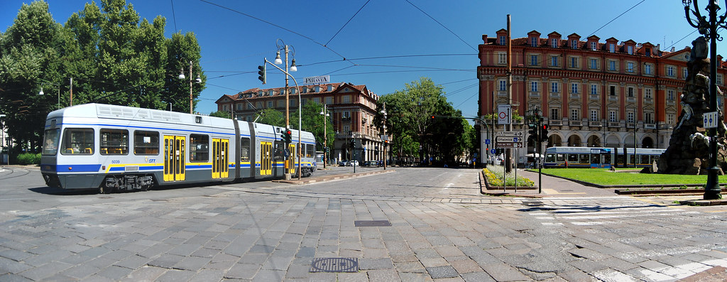
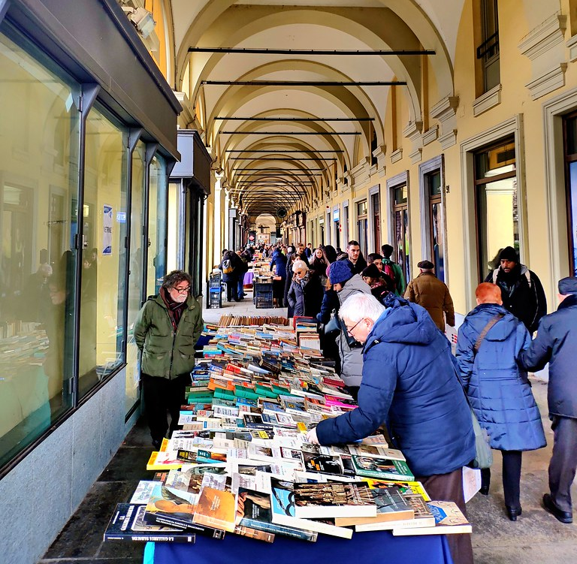
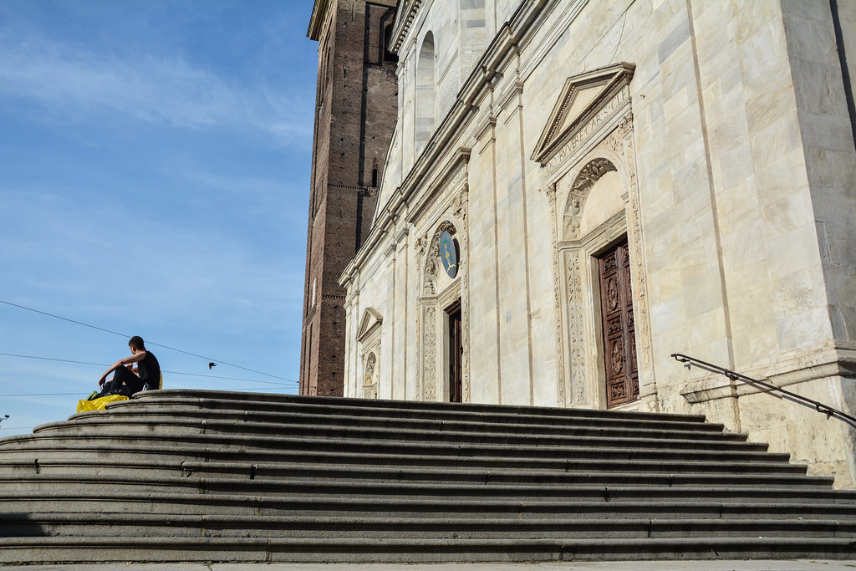
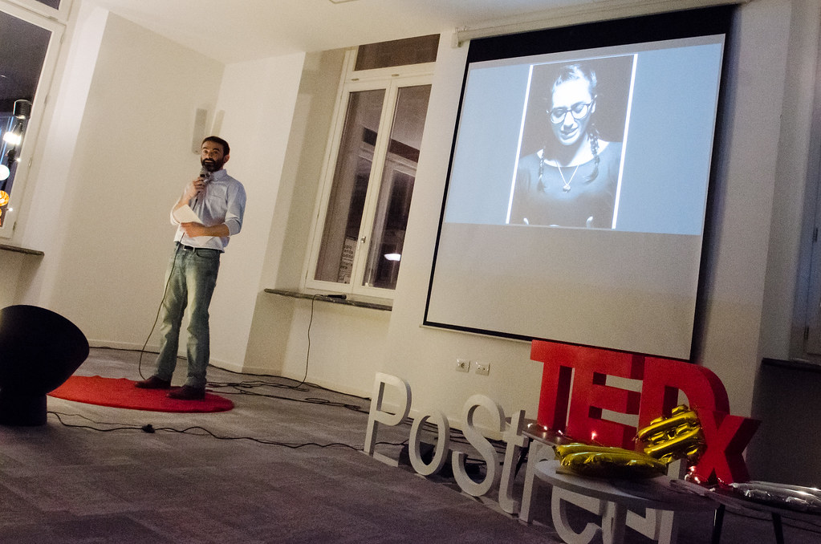
Test Readiness Review (TRR)
Zone 1
Zone 12
Zone 17
Zone 16

Slide 15
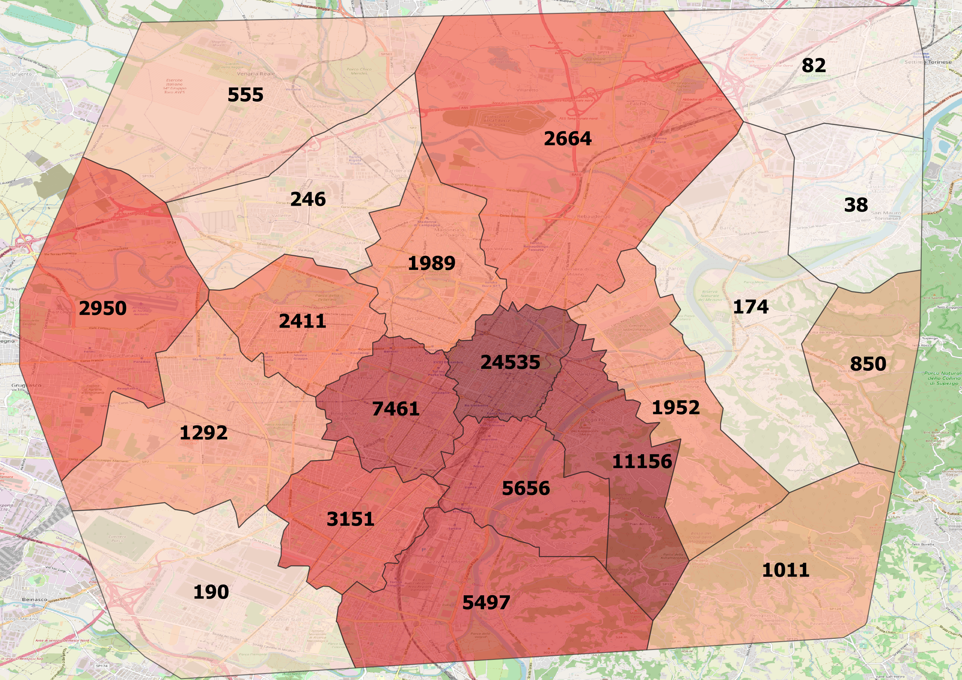
Test Readiness Review (TRR)
Inter-zone testing schedule:
Turists’ attraction capacity
Cultural resources
Cadastre’s value analysis
Crucial reminder: #photos per zone

Slide 16
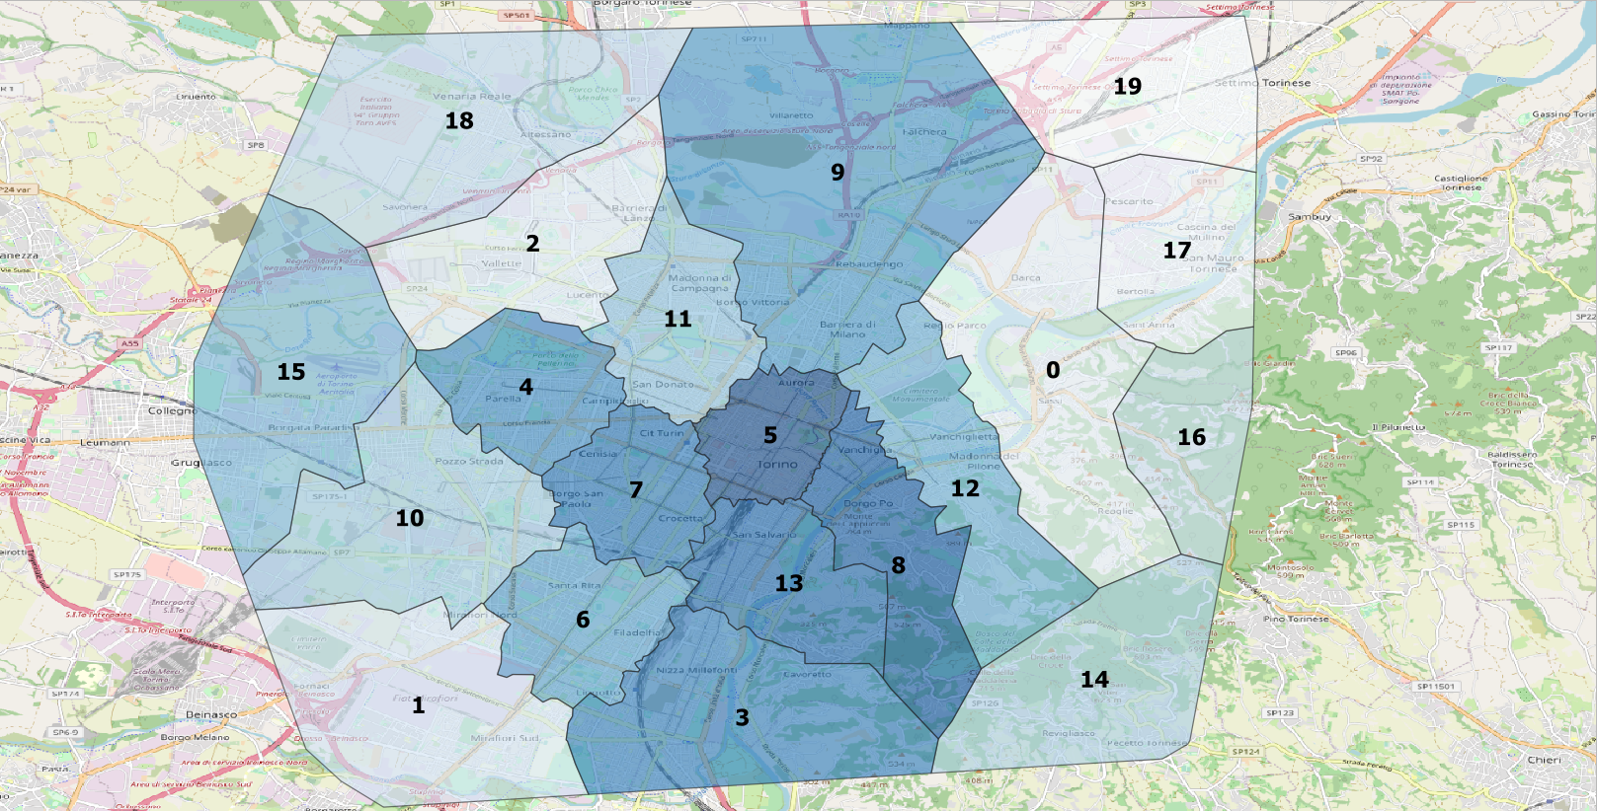
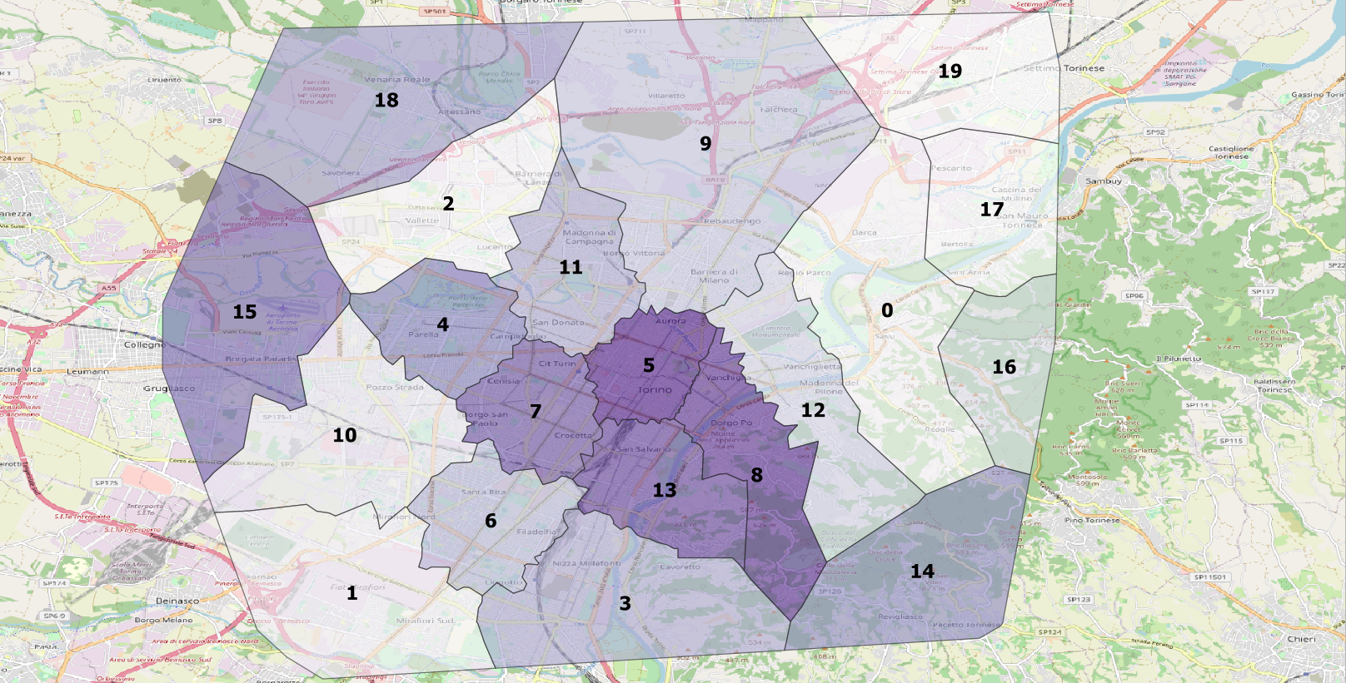
Test Readiness Review (TRR)
Turists’ attraction capacity:
f(Palaces, Food, Shopping, Exhibits)
Cultural resources:
f(Palaces, Exhibits)

Slide 17
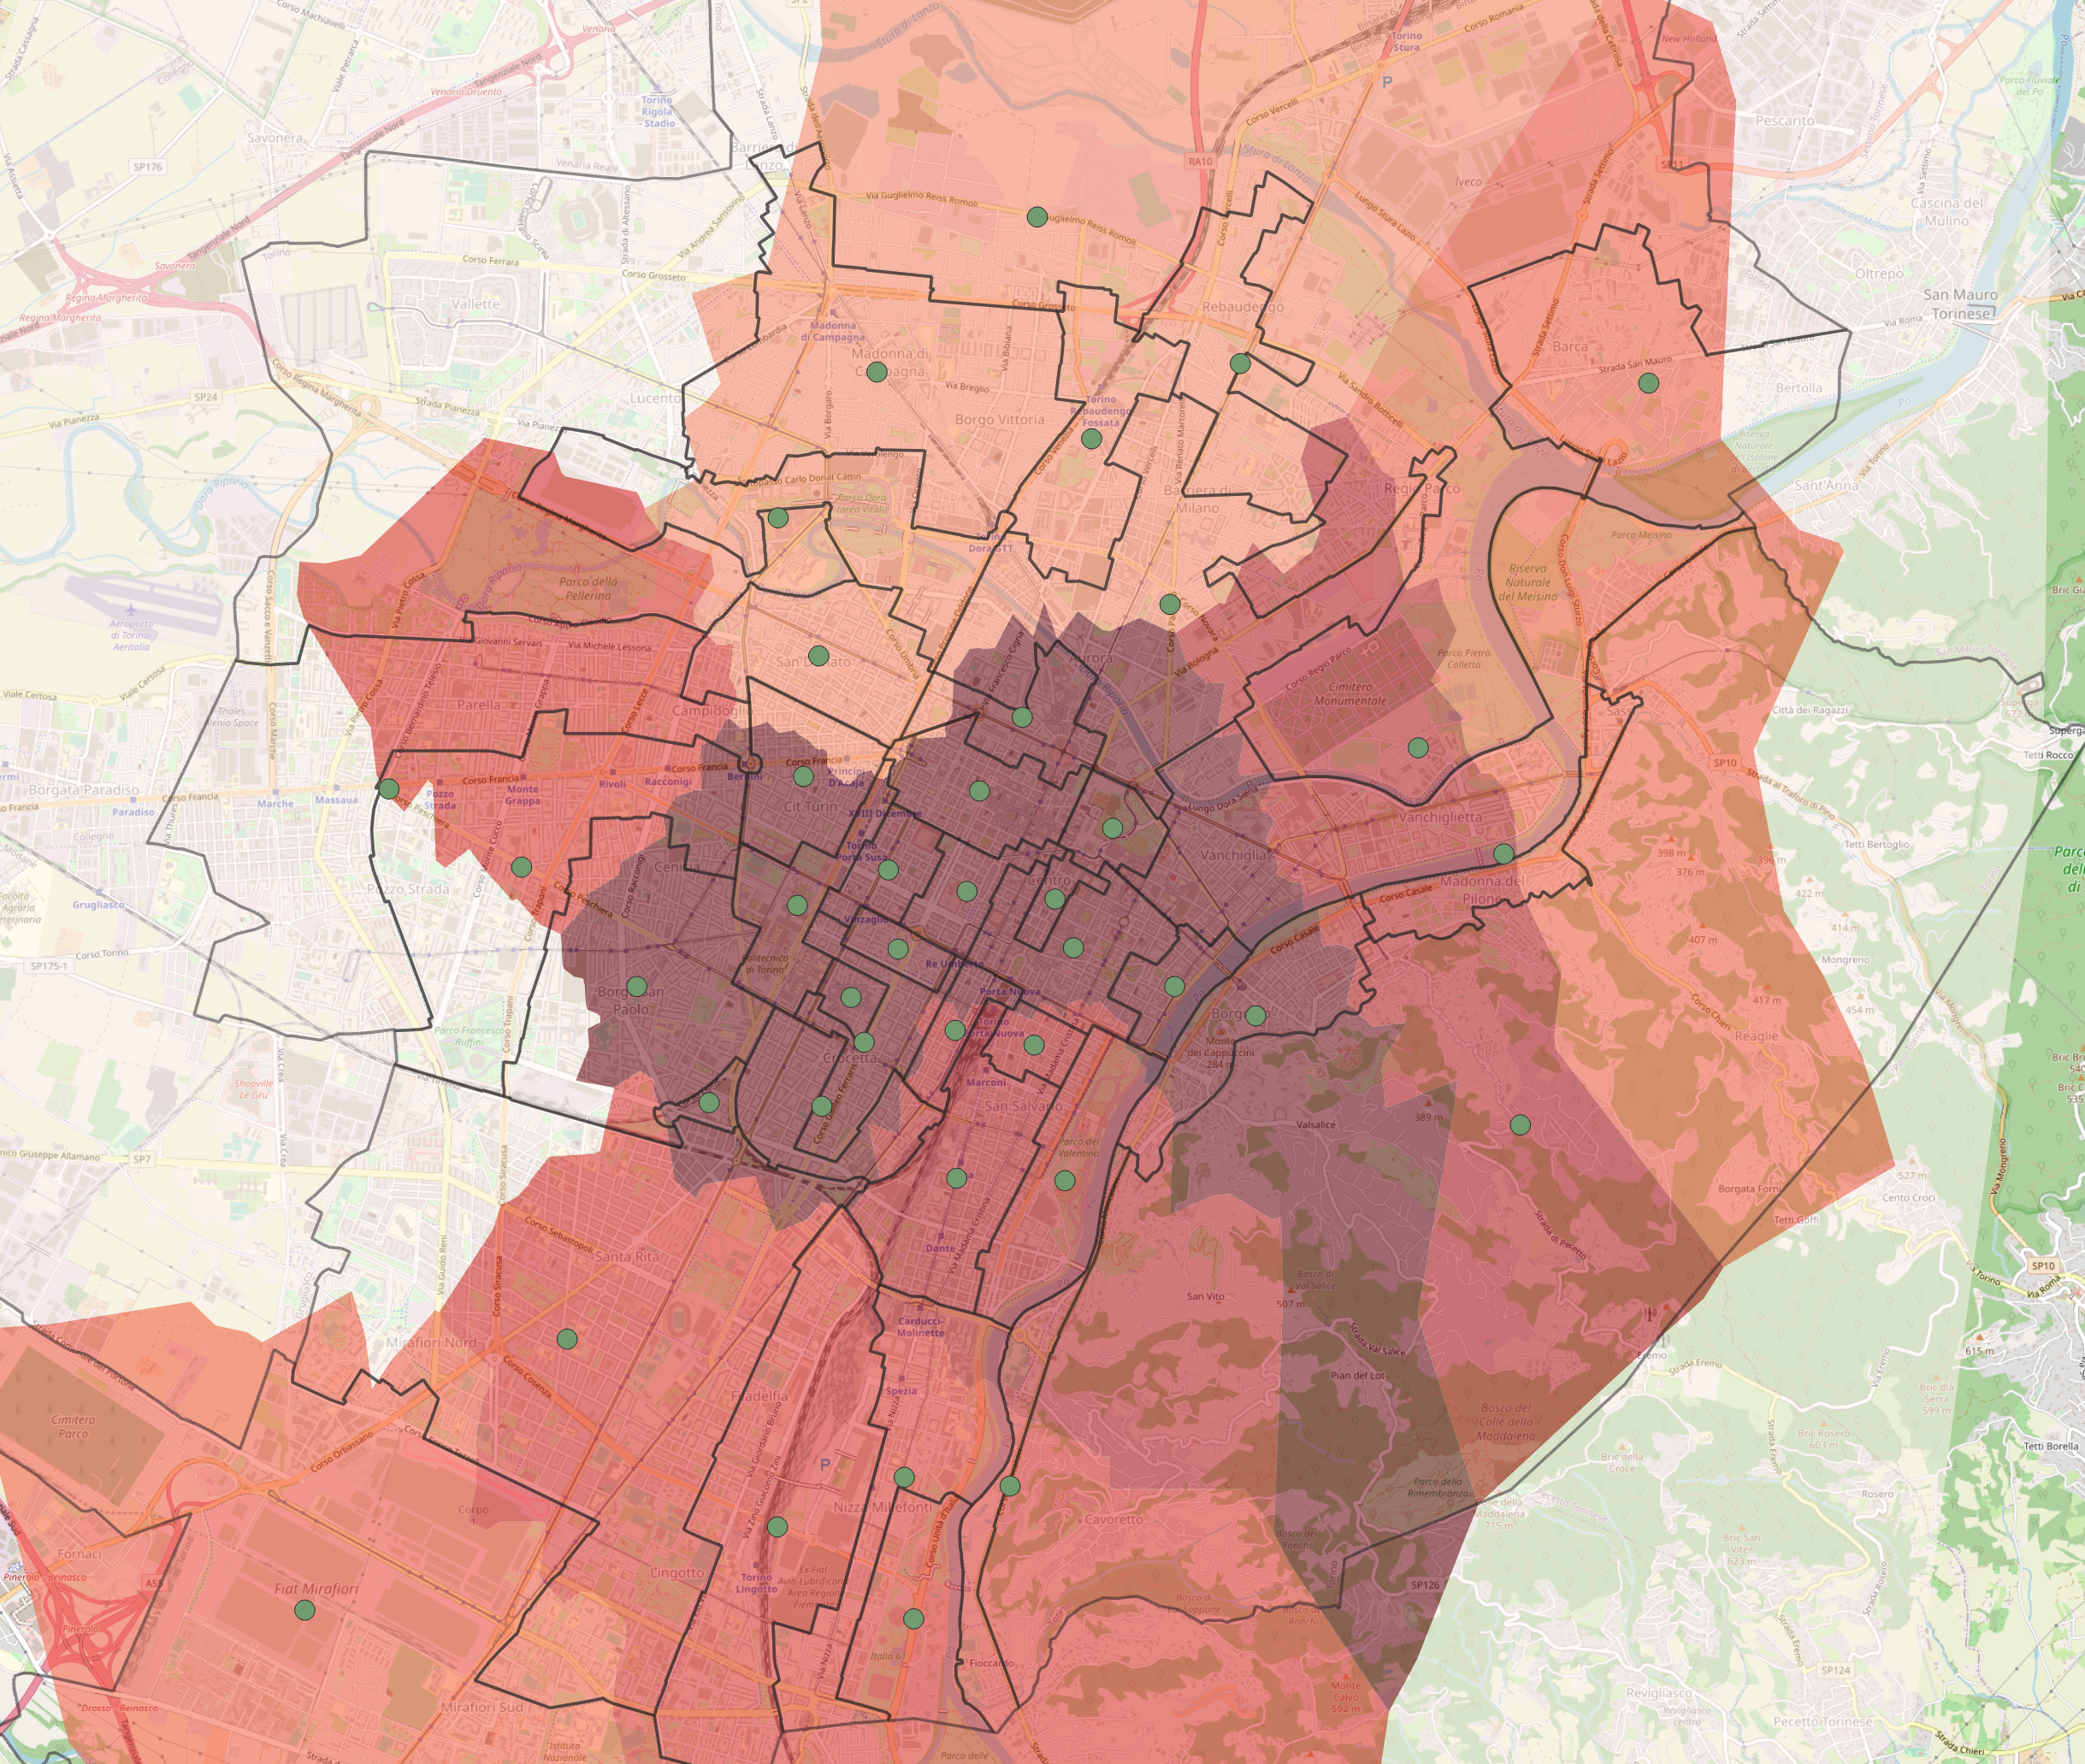
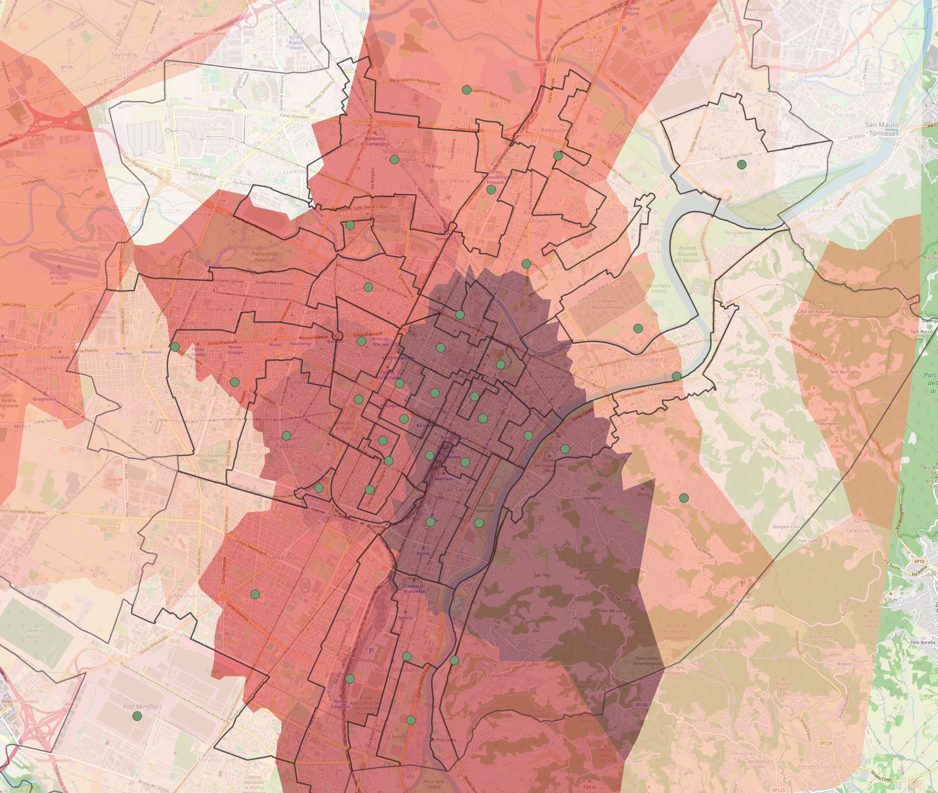
Test Readiness Review (TRR)
Real cadastral value [€/m²]
Synthetic cadastral value:
f(Palaces, Shopping, Transportation, Natural_view)

Slide 18
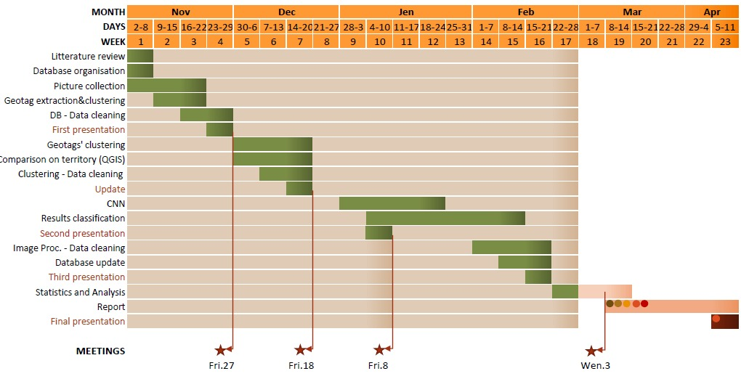
GANTT

Slide 19
THANK YOU for the attention

